Slide 1
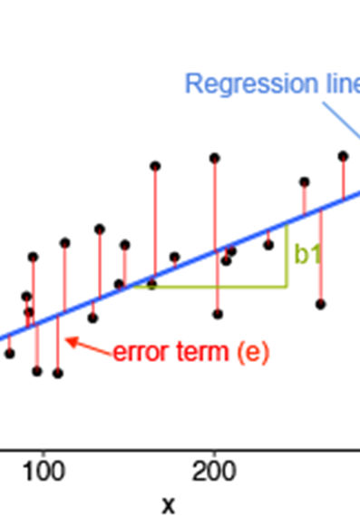
Predicting Student Grades Using Linear Regression A Project on Regression Analysis
Notes:
Good [morning/afternoon], today I’ll be presenting a data science project focused on predicting student grades using linear regression. We will walk through the process of data preparation, model development, evaluation, and interpretation of results.

Slide 2
Predicting final grades using linear regression.
Dataset: 15 student records with features like hours studied, previous grades, and attendance.
Demonstrate linear regression techniques, evaluate the model, and interpret the results.
Notes:
In this project, the goal is to predict student final grades using a linear regression model. We used a dataset of 15 student records containing variables such as hours studied, previous grades, and attendance. The objective of this analysis is to show how we can apply linear regression, evaluate the model's performance, and interpret the results to understand how these factors affect student performance.

Slide 3
Data Preparation
Data Collection: Dataset of 15 students with hours studied, previous grades, and attendance.
Data Cleaning: No missing values or outliers detected. Ensured data consistency.
Feature Selection: Chose hours studied, previous grade, and attendance as independent variables based on relevance.
Data Splitting: 80% training data, 20% testing data.
Notes:
I began by collecting data for 15 students with relevant features like hours studied, previous grades, and attendance. After collecting the data, I performed data cleaning, ensuring there were no missing values or outliers. All the data was consistent, making it ready for analysis.
For feature selection, we chose hours studied, previous grade, and attendance as independent variables, as these are likely to affect final grades. We split the data into 80% for training the model and 20% for testing it, ensuring that the model can be evaluated on unseen data.

Slide 4
Model Development
Linear Regression Formula: y=b0+b1x1+b2x2+b3x3y = b_0 + b_1x_1 + b_2x_2 + b_3x_3y=b0​+b1​x1​+b2​x2​+b3​x3​
Training the Model: Using the training data to calculate coefficients for hours studied, previous grade, and attendance.
Notes:
For the linear regression model, the formula is expressed as y=b0+b1x1+b2x2+b3x3y = b_0 + b_1x_1 + b_2x_2 + b_3x_3y=b0​+b1​x1​+b2​x2​+b3​x3​, where yyy represents the predicted final grade, and x1,x2,x3x_1, x_2, x_3x1​,x2​,x3​ represent hours studied, previous grades, and attendance, respectively. The coefficients b1,b2,b3b_1, b_2, b_3b1​,b2​,b3​ tell us the impact of each independent variable on the final grade.
I trained the model using our training data and calculated these coefficients, which tell us how much each factor affects the final grade.

Slide 5
Model Evaluation Metrics
MSE (Mean Squared Error): Measures the average squared difference between actual and predicted values.
MAE (Mean Absolute Error): Measures the average of the absolute differences.
R²: Proportion of variance in the dependent variable explained by the independent variables.
Notes:
To evaluate the model's performance, we use three key metrics:
MSE (Mean Squared Error), which measures the average squared difference between actual and predicted values. A lower MSE means better model performance.
MAE (Mean Absolute Error), which measures the average of the absolute differences. This gives a more intuitive understanding of prediction error.
R², which tells us the proportion of variance in the dependent variable, or final grade, explained by our independent variables. A higher R² value means the model fits the data better.
Let’s move on to see how the model performed on both the training and testing data.

Slide 6
Model Analysis
Performance Evaluation:
MSE: 0.86 (training), 6.98 (testing); MAE: 0.74 (training), 2.54 (testing); R²: 0.997 (training), 0.974 (testing).
Residual Analysis: Residuals show no significant patterns, meeting assumptions of linear regression.
Notes:
For the performance evaluation, the training data resulted in a low MSE of 0.86, and a low MAE of 0.74, indicating the model’s accuracy. The R² value for training was 0.997, meaning the model explains 99.7% of the variance in the training data.
On the testing data, the model’s performance was also good: MSE = 6.98, MAE = 2.54, and R² = 0.974. This indicates that the model generalizes well to unseen data, with a slightly higher error on testing.
We also performed residual analysis to ensure that the model assumptions were met. The residuals show no significant patterns, confirming that the model is appropriate for this data.

Slide 7
Interpretation of Coefficients
Hours Studied: Coefficient = 0.509. For each additional hour studied, the final grade increases by 0.509 points.
Previous Grade: Coefficient = -0.105. Higher previous grades slightly reduce the predicted final grade.
Attendance: Coefficient = 1.11. Higher attendance significantly increases the predicted final grade.
Intercept: -11.63. Predicted final grade when all predictors are zero.
Notes:
Now, let’s interpret the coefficients from our model:
Hours Studied has a coefficient of 0.509, meaning that for each additional hour studied, the final grade increases by 0.509 points.
The Previous Grade coefficient is -0.105, suggesting that as previous grades increase, the predicted final grade slightly decreases, perhaps due to diminishing returns with a higher base grade.
Attendance has the largest positive coefficient of 1.11, showing that higher attendance significantly increases the final grade, which is expected as regular attendance likely leads to better performance.
The intercept is -11.63, which is the predicted final grade when all predictors are zero. While this scenario is unrealistic, it helps define the regression line.

Slide 8
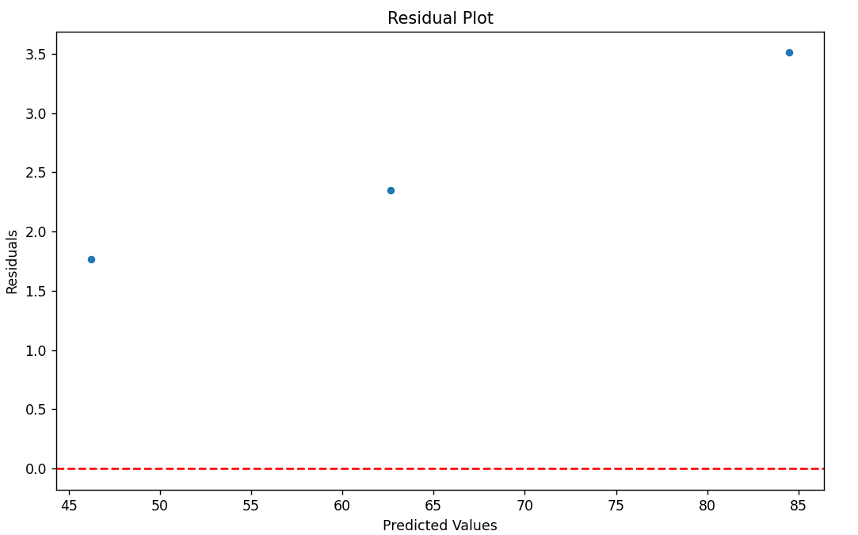
Residual Analysis
Observations:
Residuals are randomly distributed.
No clear pattern indicates the model fits well.
Residuals are within acceptable ranges.
Notes:
Residual analysis ensures that the model’s assumptions are met. Here, the residuals show no discernible pattern, confirming the model's validity.

Slide 9
Interpretation of Results
Key Findings:
Hours_Studied and Attendance positively influence Final_Grade.
Previous_Grade has a slight negative impact.
Implications: Focus on study hours and attendance to improve grades.
Notes:
The results highlight the importance of study hours and attendance in predicting grades. Interestingly, prior grades have a slight negative impact, which might indicate diminishing returns for higher grades.

Slide 10
Model Limitations
Linearity Assumption: Assumes linear relationships, which might not hold for more complex data.
Multicollinearity: Potential correlations between independent variables could affect the model's reliability.
Limited Data: With only 15 records, the model may not generalize well to larger datasets.
Notes:
Linearity Assumption: We assumed a linear relationship between the features and the final grade. In reality, this might not always hold true, and more complex models may be needed.
Multicollinearity: There could be correlations between some features, like hours studied and attendance, which could affect the model’s reliability. We haven’t explicitly tested for this, but it's a common concern in regression models.
Limited Data: Our dataset consists of only 15 records, which is relatively small. This limits the model's ability to generalize to larger or more diverse datasets.

Slide 11
Thank you
Chandrashekar Mahesh
maheshc@csp.edu

